Slide 1
Blacktown Chinese Christian Church
Welcome to Our English Service 28.12.2025
English Service 9:45 – 11:00 am
Worship Songs: Passage: Speaker: Topic: Response Song: Announcements and Closing Prayer Benediction
N/A Paul Lee ( Senior) Q and A about God and Faith TBA

Slide 2
BCCC english service

Slide 3

Please keep all phones on silent

Slide 4
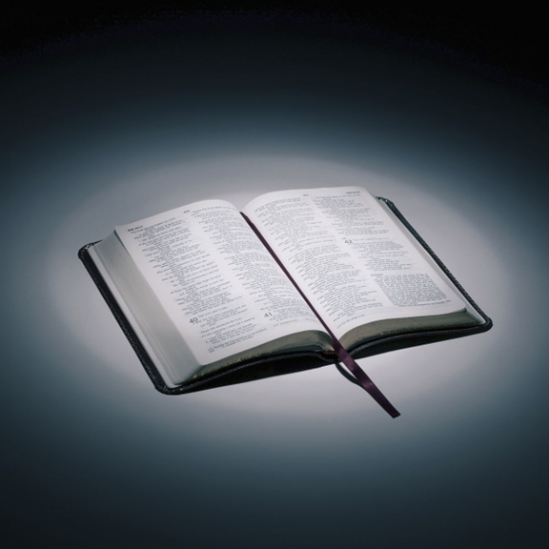
Bible reading

Slide 5
N/A
A prophecy concerning Nineveh. The book of the vision of Nahum the Elkoshite.
² The Lord is a jealous and avenging God;
the Lord takes vengeance and is filled with wrath.
The Lord takes vengeance on his foes
and vents his wrath against his enemies.

Slide 6
N/A
³ The Lord is slow to anger but great in power;
the Lord will not leave the guilty unpunished.
His way is in the whirlwind and the storm,
and clouds are the dust of his feet.

Slide 7
N/A
⁴ He rebukes the sea and dries it up;
he makes all the rivers run dry.
Bashan and Carmel wither
and the blossoms of Lebanon fade.

Slide 8
N/A
⁵ The mountains quake before him
and the hills melt away.
The earth trembles at his presence,
the world and all who live in it.

Slide 9
N/A
⁶ Who can withstand his indignation?
Who can endure his fierce anger?
His wrath is poured out like fire;
the rocks are shattered before him.

Slide 10
N/A
⁷ The Lord is good,
a refuge in times of trouble.
He cares for those who trust in him,
⁸ but with an overwhelming flood
he will make an end of Nineveh;
he will pursue his foes into the realm of darkness.

Slide 11
N/A
⁹ Whatever they plot against the Lord
he will bring to an end;
trouble will not come a second time.
¹⁰ They will be entangled among thorns
and drunk from their wine;
they will be consumed like dry stubble.

Slide 12
N/A
¹¹ From you, Nineveh, has one come forth
who plots evil against the Lord
and devises wicked plans.
¹² This is what the Lord says:
“Although they have allies and are numerous,
they will be destroyed and pass away.
Although I have afflicted you, Judah,
I will afflict you no more.

Slide 13
N/A
¹³ Now I will break their yoke from your neck
and tear your shackles away.”
¹⁴ The Lord has given a command concerning you, Nineveh:
“You will have no descendants to bear your name.
I will destroy the images and idols
that are in the temple of your gods.
I will prepare your grave,
for you are vile.”

Slide 14
N/A
¹⁵ Look, there on the mountains,
the feet of one who brings good news,
who proclaims peace!
Celebrate your festivals, Judah,
and fulfill your vows.
No more will the wicked invade you;
they will be completely destroyed.

Slide 15
Announcements

Slide 16





Account name: Blacktown Chinese Christian Church
Account number: 4216 50263
Offering
BSB: 112 - 879
Please put in "offering" as the reference
The offering box is available at the back of the hall

Slide 17
Prayer points

Slide 18
Mingle time!

